Slide 1

Exam AZ-304: Microsoft Azure Architect Design Crash Course
Tim Warner

Slide 2


Tim Warner
Based in Nashville, TN, US
Central time zone
MCT, MVP
Twitter: @TechTrainerTim
Badge: TechTrainerTim.com

Slide 3
Day 1 of 2 Agenda
Introduction
Identity and Security Design
Storage Data Design
Monitoring Design

Slide 4
Day 2 of 2 Agenda
Content catch-up
Business Continuity Design
Infrastructure Design
Exam AZ-304 strategy

Slide 5
Course Materials
timw.info/az304

Slide 6
A Different Kind of Training
We'll learn by doing – at least 80 percent demo
Visual, case study approach
This is an expert certification, so we move quickly and assume intermediate-level Azure skills
10-minute break at midpoint
I’m here to answer your questions – take advantage of this!
Use the Q&A panel

Slide 7

Session Recordings

Slide 8
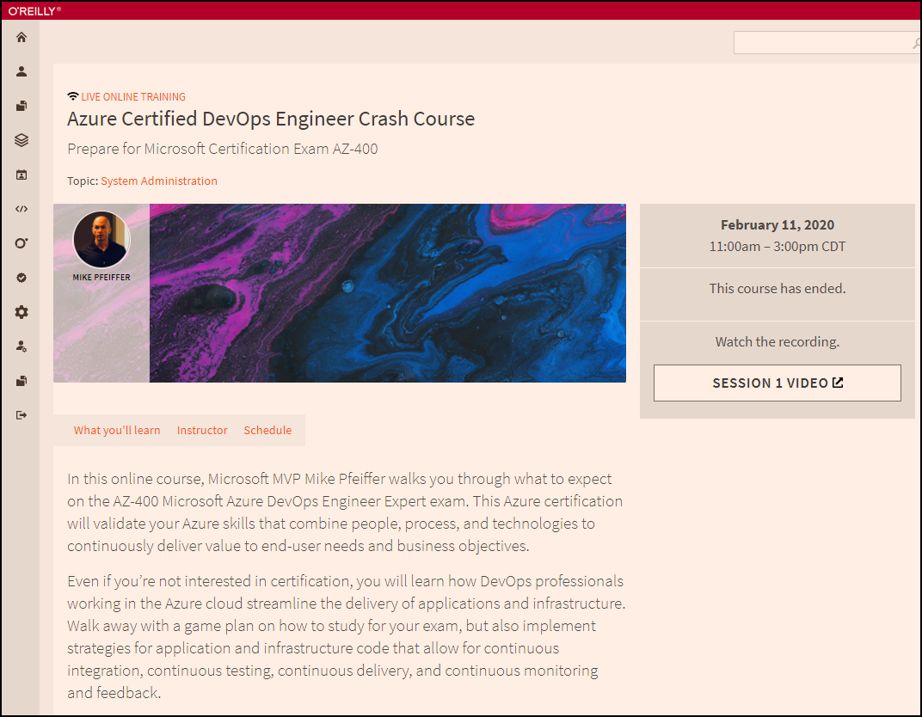
Session Recordings

Slide 9

Session Recordings

Slide 10
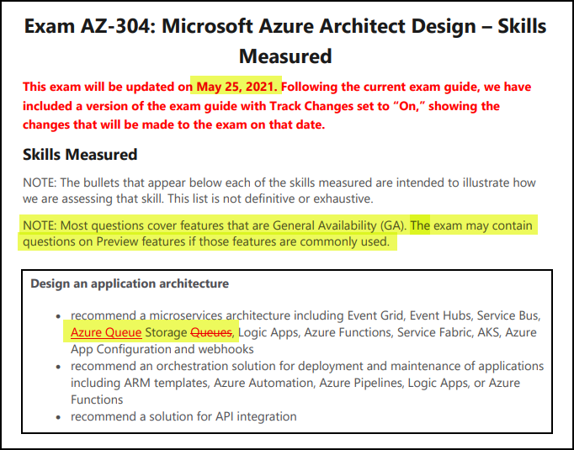
AZ-304 Changes: May 25, 2021

Slide 11
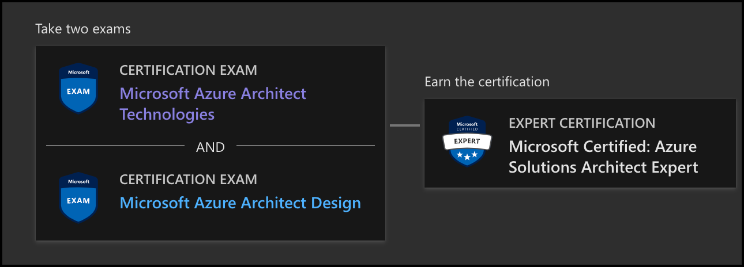
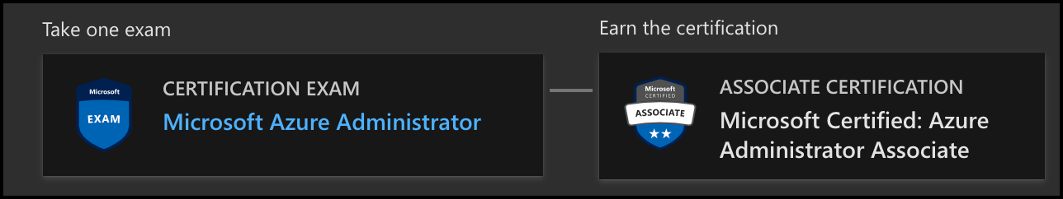
Azure Architect Certification
AZ-303
AZ-304
AZ-104

Slide 12

Tim's Certification Study Model
Content knowledge
Test-taking skills
Practical application

Slide 13
Thank you!
Course materials: timw.info/az304
Twitter: @TechTrainerTim
Work: timw.info/ps
Web: TechTrainerTim.com

Slide 14
Authentication

Slide 15

Tenant vs. Subscription

Slide 16

Hybrid Identity

Slide 17

Azure AD B2C

Slide 18
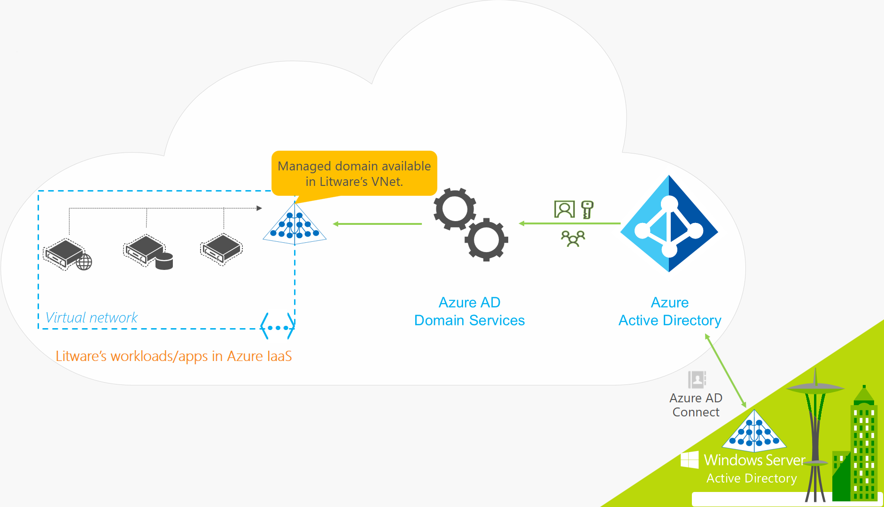
Azure AD Domain Services

Slide 19
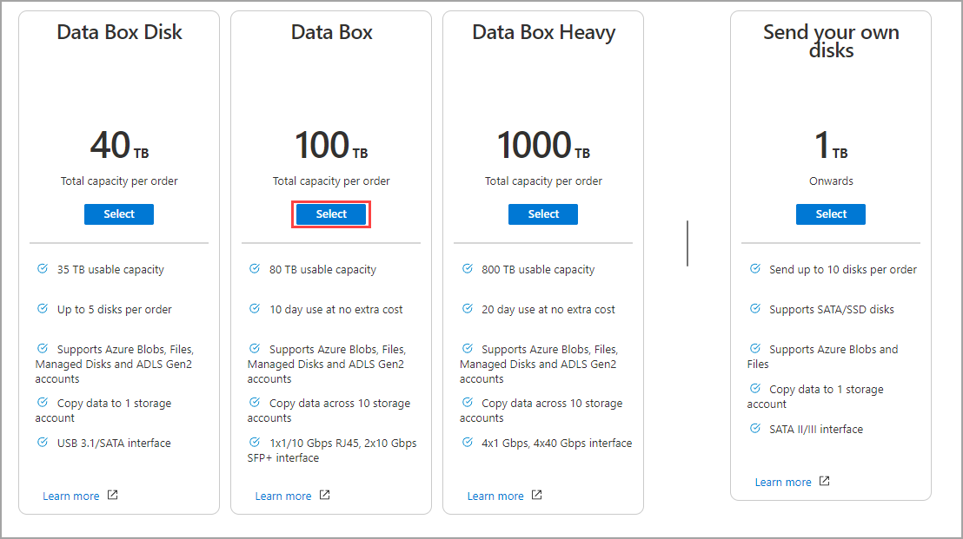
Azure Data Box

Slide 20

Passthrough Authentication

Slide 21

Seamless Single Sign-on

Slide 22
Authorization and Governance

Slide 23

Azure Management Scopes
/ Tenant Root

Slide 24
Azure Storage

Slide 25

Data Pipelines

Slide 26
Monitoring

Slide 27

Azure Diagnostics

Slide 28

Log Analytics

Slide 29

Sentinel

Slide 30
Storage Account Replication
1
3
3
2
LRS
ZRS

Slide 31
Storage Account Replication
3
3
GRS/RA-GRS

Slide 32
Storage Account Replication
1
3
1
3
2
2
GZRS – RA/GZRS

Slide 33

Always Encrypted

Slide 34
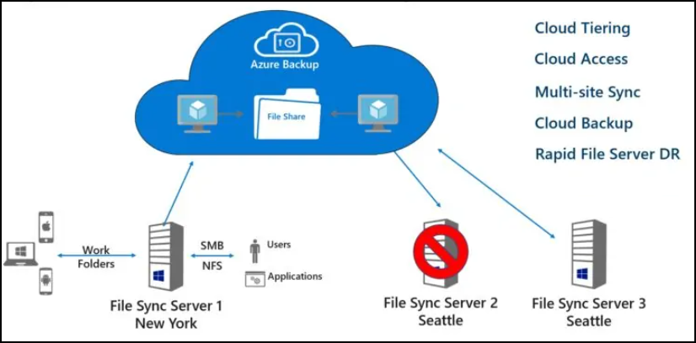
Azure File Sync

Slide 35
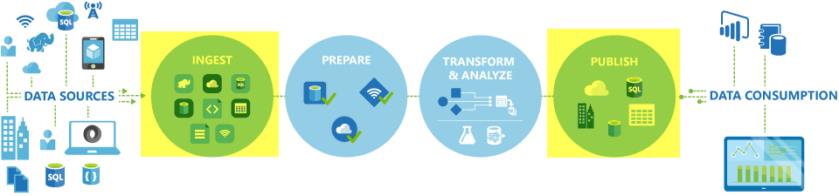
Azure Data Factory

Slide 36
Azure Monitor

Slide 37
Migration and Disaster Recovery

Slide 38

Azure Backup

Slide 39

Azure Site Recovery

Slide 40
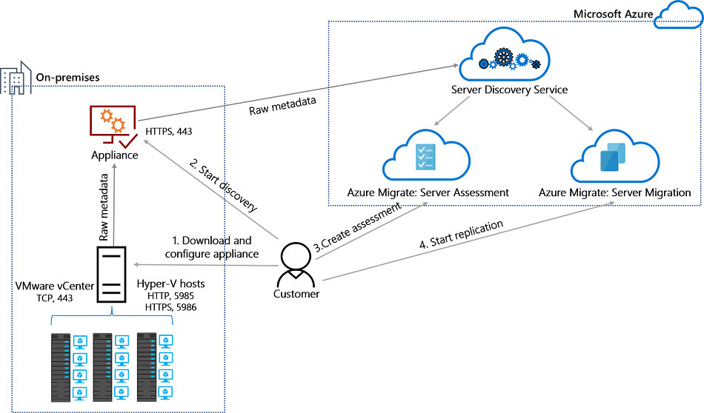
Azure Migrate

Slide 41
Azure Compute

Slide 42

VM Scale Sets

Slide 43
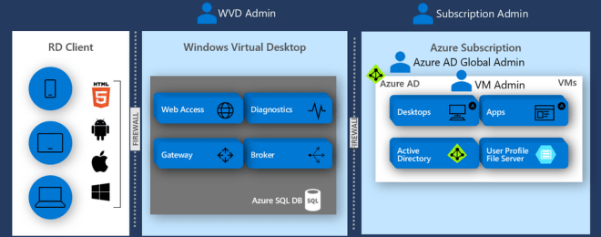
Windows Virtual Desktop (WVD)
timw.info/travis

Slide 44

Availability Set

Slide 45

Availability Zone

Slide 46
Load Balancing

Slide 47

VM Networking

Slide 48

Load Balancing

Slide 49

VNet Peering

Slide 50

Hybrid Networking

Slide 51

Network Virtual Appliance

Slide 52

Azure Load Balancer

Slide 53

Application Gateway

Slide 54

Traffic Manager

Slide 55

Front Door Service

Slide 56
Containers

Slide 57


Docker Container Lifecycle
https://timw.info/3635f

Slide 58
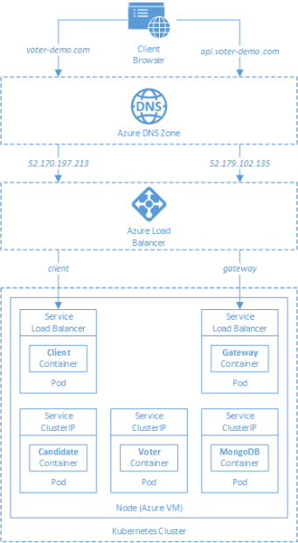
AKS

Slide 59
App Architecture

Slide 60

Event Architecture

Slide 61

Event Architecture

Slide 62
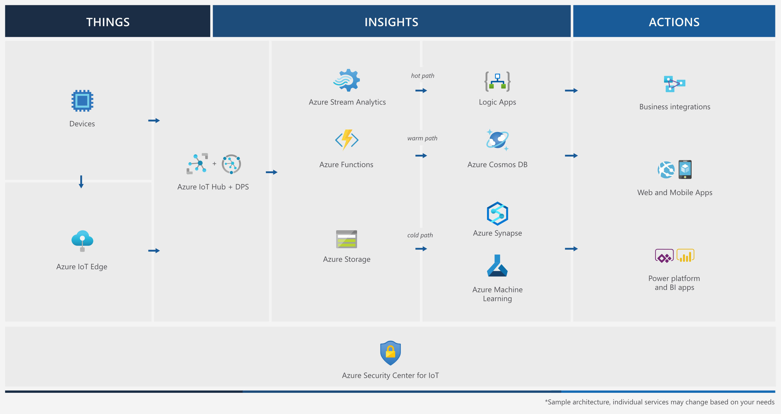
Event Architecture

Slide 63
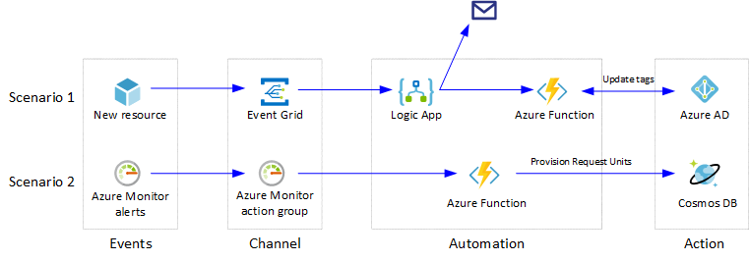
Event Architecture

Slide 64
Exam AZ-304 Item Types

Slide 65

Multiple Choice

Slide 66
Repeated Scenario
You need to move an Azure VM to another hardware host.
Solution: You redeploy the VM.
Does this solution meet the goal?
Yes
No

Slide 67

Select and Place

Slide 68

Build List and Reorder

Slide 69

Active Screen/Fill in the Blank

Slide 70

Case Study

Slide 71






Performance-Based Lab

Slide 72
Microsoft Online Testing

Slide 73
Microsoft Online Testing Process
timw.info/online

Slide 74

Microsoft Online Testing Process

Slide 75

Microsoft Online Testing Process

Slide 76

Microsoft Online Testing Process

Slide 77

Microsoft Online Testing Process

Slide 78

Microsoft Online Testing Process

Slide 79

Microsoft Online Testing Process

Slide 80

Microsoft Online Testing Process

Slide 81
AZ-304 Exam Strategy
Focus your skills accordingly:
60 percent Azure portal
20 percent Azure PowerShell
10 percent Azure CLI
10 percent KQL
Expect performance-based labs, but be thankful if you don't see 'em

